Slide 1
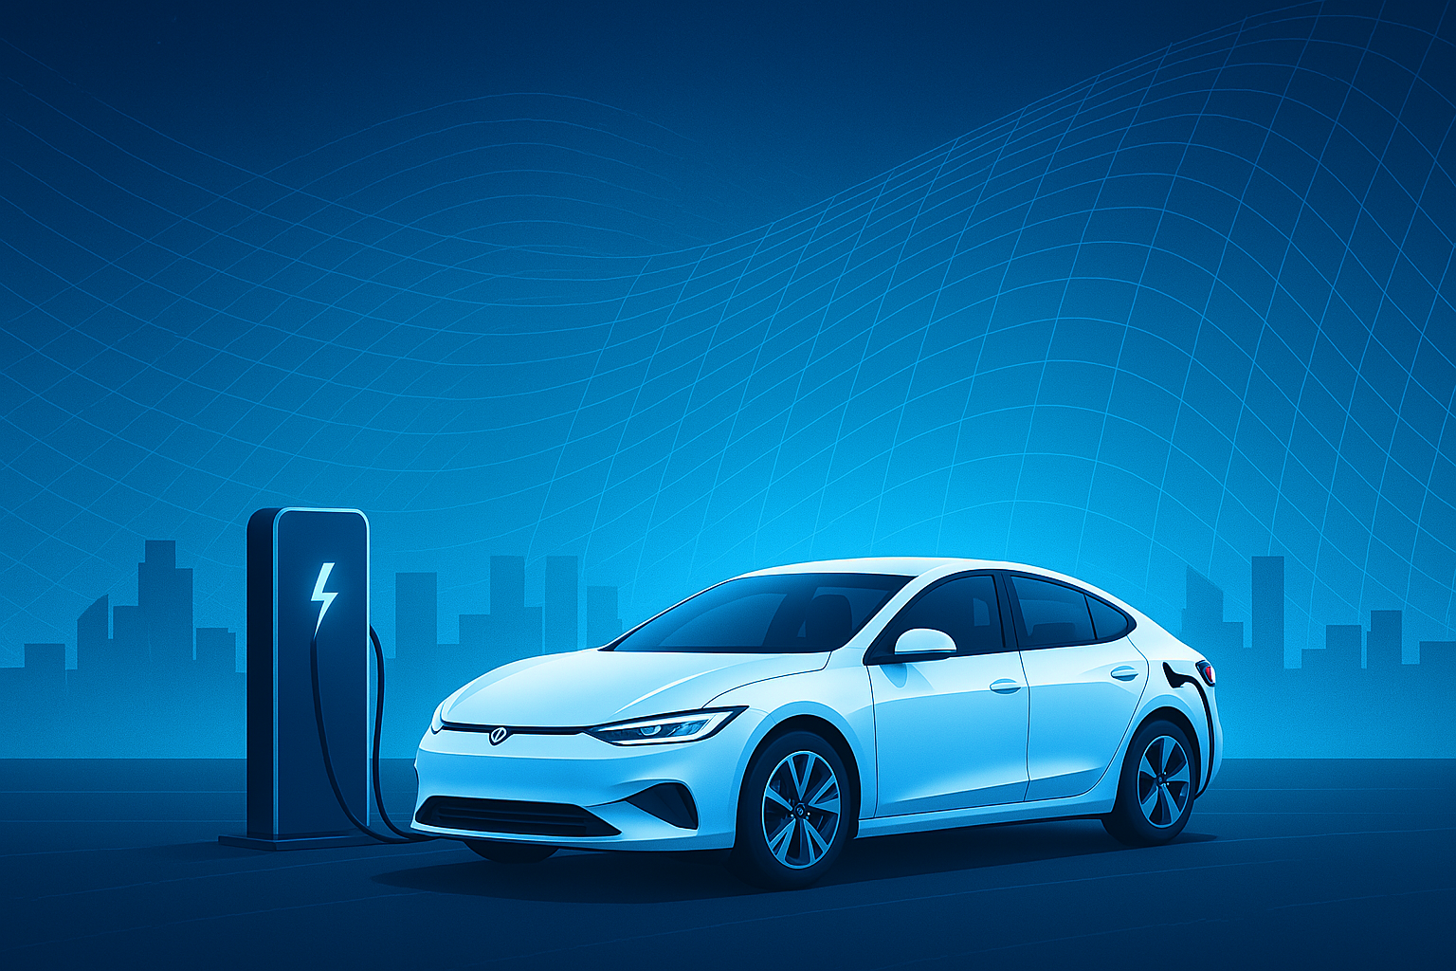

Work Experience Project – 1 Atliq Motors EV
Presented By : Shikhar Singh

Slide 2
•Introduction
•Problem statement
•Dashboard preview
•Primary research questions
•Secondary research questions
•Recommendations
•Conclusion

Slide 3
AtliQ Motors: Strategic Expansion into India
🏢Company Overview:
AtliQ Motors is a U.S.-based automotive leader, renowned for:
Cutting-edge Electric Vehicles (EVs) and Hybrid Technology.
A strong focus on sustainability, performance, and innovation.
Currently holds a 25% market share in the North American EV/hybrid vehicle segment.
🌍 Why India?
India presents a rapidly growing EV market, driven by:
Government initiatives and incentives.
Rising consumer interest in sustainable transport.
AtliQ Motors' market share in India is currently below 2%, indicating huge growth potential.
🚀 Expansion Strategy
Plan to introduce bestselling EV and hybrid models to the Indian market.
The goal: Increase presence, capture market share, and compete with local and global EV manufacturers.

Slide 4
🧠 Leadership Insight
Bruce Haryali, Chief of AtliQ Motors India, is leading the expansion effort.
He emphasizes the need for a data-driven market strategy before launching.
📈 Data-Driven Decision Making
A comprehensive market research initiative was launched to study:
Current EV/hybrid adoption trends.
Competitive landscape.
Consumer behavior and preferences.
The task was assigned to the Data Analytics Team at AtliQ Motors.
👨‍💻 Meet the Analyst
Peter Pandey, a skilled data analyst on the team, is:
Responsible for compiling and analyzing relevant Indian market data.
Expected to deliver insights to guide AtliQ’s expansion roadmap.
• Problem Statements:

Slide 5
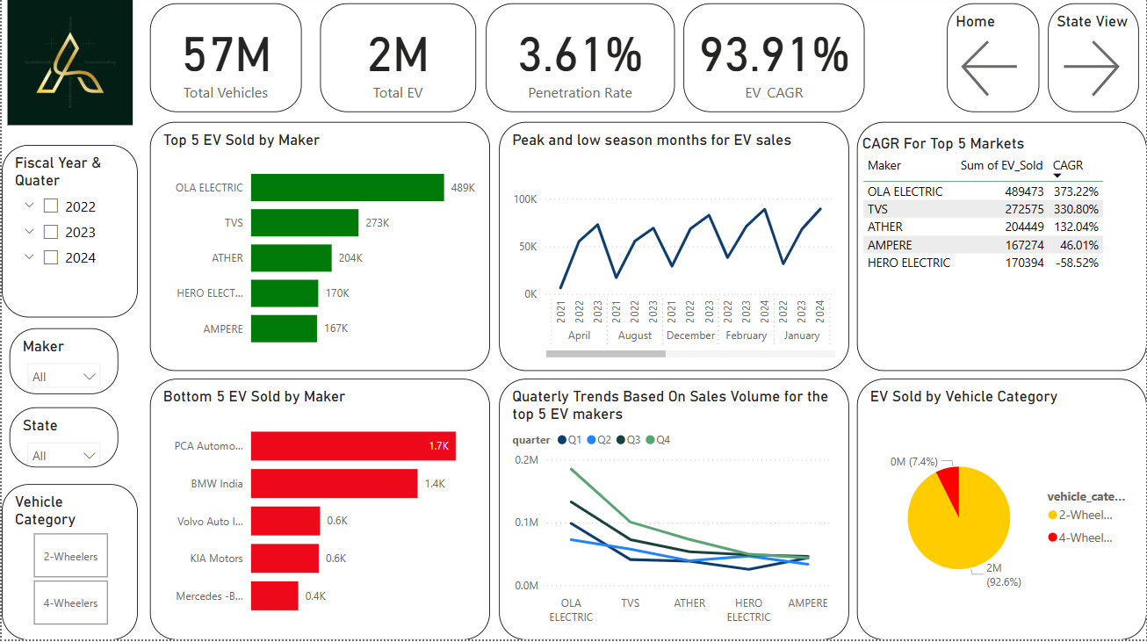

Slide 6
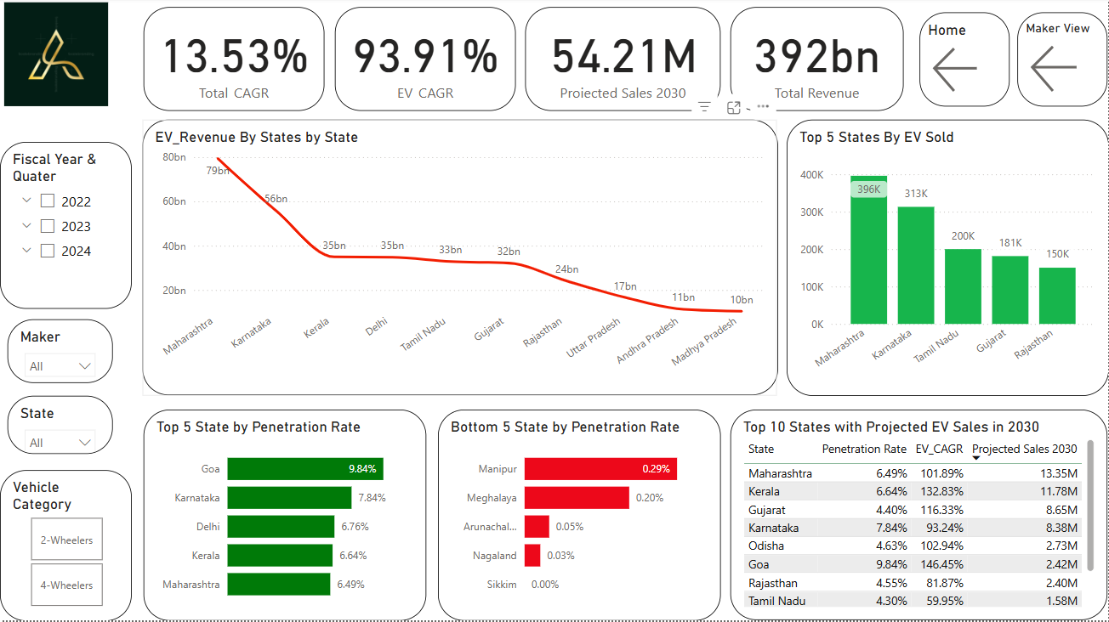

Slide 7
Preliminary Research Questions

Slide 8
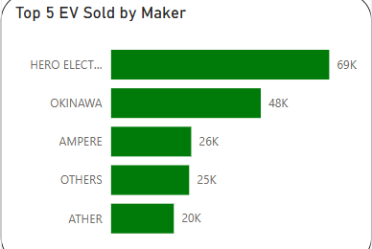
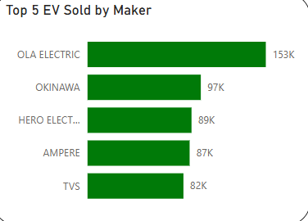
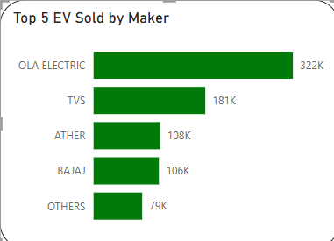
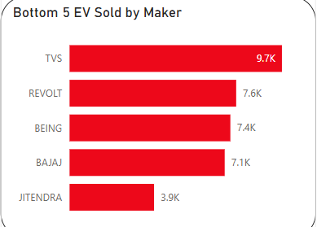
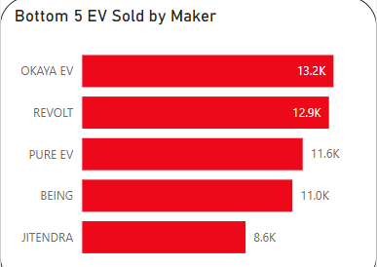
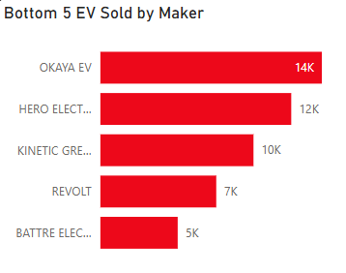
1. List the top 3 and bottom 3 makers for the fiscal years 2023 and 2024 in terms of the number of 2-wheelers sold.
Fiscal Year 2022
Fiscal Year 2023
Fiscal Year 2024

Slide 9
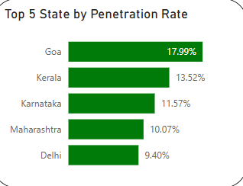
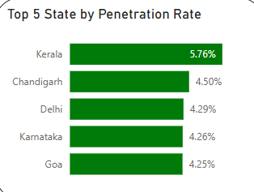
2. Identify the top 5 states with the highest penetration rate in 2-wheeler and 4-wheeler EV sales in FY 2024.
2 - Wheelers
4 - Wheelers

Slide 10
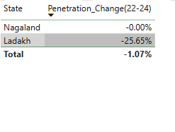
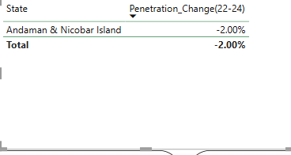
3. List the states with negative penetration (decline) in EV sales from 2022 to 2024?

Slide 11
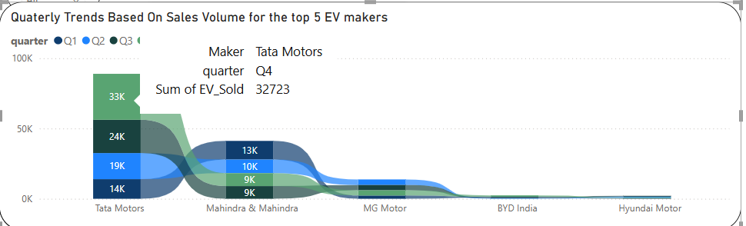
4. What are the quarterly trends based on sales volume for the top 5 EV makers (4-wheelers) from 2022 to 2024?

Slide 12
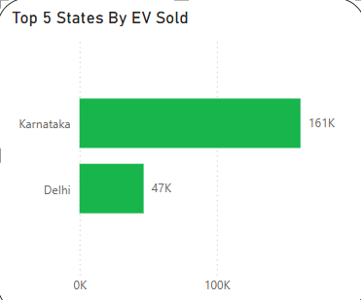
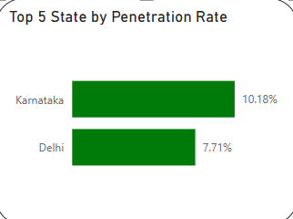
5. How do the EV sales and penetration rates in Delhi compare to Karnataka for 2024?

Slide 13
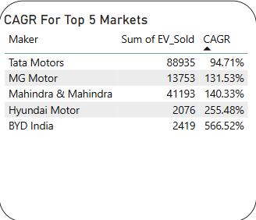
6. List down the compounded annual growth rate (CAGR) in 4-wheeler units for the top 5 makers from 2022 to 2024.

Slide 14
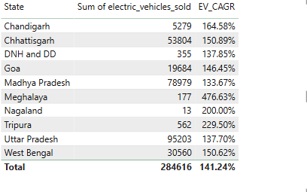
7. List down the top 10 states that had the highest compounded annual growth rate (CAGR) from 2022 to 2024 in total vehicles sold.

Slide 15
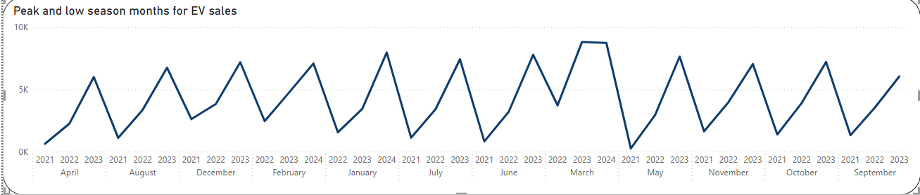
8. What are the peak and low season months for EV sales based on the data from 2022 to 2024?

Slide 16
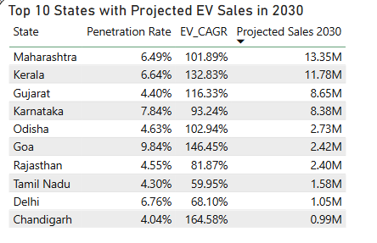
9. What is the projected number of EV sales (including 2-wheelers and 4 wheelers) for the top 10 states by penetration rate in 2030, based on the compounded annual growth rate (CAGR) from previous years?

Slide 17
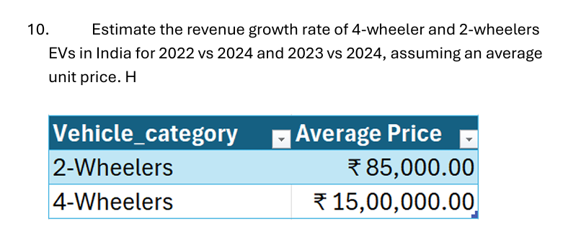
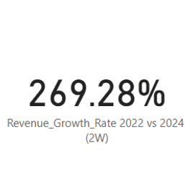
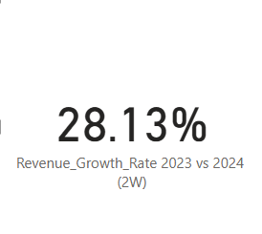
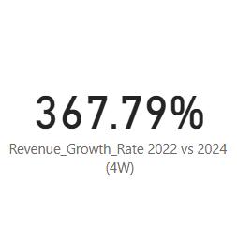
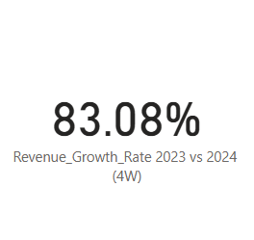

Slide 18
Secondary Research Questions

Slide 19
1. What are the primary reasons for customers choosing 4-wheeler EVs in 2023 and 2024 (cost savings, environmental concerns, government incentives)?
1. Cost Savings:
Fuel Efficiency: EVs are far more efficient than internal combustion engine (ICE) vehicles. They consume significantly less energy per kilometer, reducing fuel expenses dramatically—especially in cities with frequent stop-and-go traffic.
Low Maintenance: EVs have fewer moving parts—no engine oil, fewer fluids, and no exhaust systems. This leads to lower maintenance costs and fewer service visits, making them more economical in the long run.
2. Environmental Concerns:
Zero Emissions: 4W EVs produce no tailpipe emissions, helping reduce air pollution in heavily congested urban areas. This contributes directly to better public health and environmental outcomes.
Sustainability Appeal: With rising awareness around climate change, EVs are viewed as a clean, future-ready alternative to ICE vehicles. Consumers are increasingly motivated by environmental responsibility and sustainable living.
3. Government Incentives:
Financial Support: Most states and the central government offer subsidies, income tax benefits, and reduced road tax, making EVs more financially accessible.
Faster Permits & Registration: EV buyers benefit from priority registration, exemptions on tolls, and easier green permits in several cities, enhancing the ease of ownership and daily use.

Slide 20
2. How do government incentives and subsidies impact the adoption rates of 2-wheelers and 4-wheelers? Which states in India provided most subsidies?
2-Wheelers (2W):
Government incentives make entry-level EVs more affordable, reducing the upfront cost gap between EVs and petrol scooters.
State subsidies (₹5,000–₹15,000 per vehicle) significantly influence mass-market adoption in cities and semi-urban regions.
Faster registration, exemption from road tax, and free charging further increase 2W EV attractiveness for daily commuters and delivery services.
4-Wheelers (4W):
Central and state incentives (under FAME II and local EV policies) offer up to ₹1.5 lakh in subsidies on eligible 4W EV models.
These incentives reduce total cost of ownership, which is especially important given the higher upfront cost of electric cars.
Additional benefits like free parking, toll waivers, and priority registration boost adoption among urban, upper-middle-class consumers.

Slide 21
3. How does the availability of charging stations infrastructure correlate with the EV sales and penetration rates in the top 5 states?
📈 Strong Positive Correlation:
The availability of public charging stations has shown a direct impact on EV sales and penetration, especially in the top-performing states. More chargers = more confidence to adopt EVs, especially 4-wheelers with longer ranges and intercity use.
State | EV Penetration | Charging Infrastructure Highlights
Delhi | High | Dense charging network in residential and commercial zones. EV policy mandates infra in new buildings.
Maharashtra | High | 2,000+ public chargers. Mumbai, Pune, Nagpur are EV infra hotspots.
Karnataka | High | Bengaluru leads with robust fast-charging networks and incentives for private setups.
Tamil Nadu | Medium-High | Rapid infra rollout, especially in Chennai; major investments in manufacturing + chargers.
Gujarat | Medium-High | Focus on tier-2 cities, with state-led infra expansion in collaboration with DISCOMs.
🔍 Key Insights:
4W EVs are more sensitive to charging infrastructure availability than 2W, as range anxiety is a greater concern.
States that proactively planned charging infrastructure saw faster EV adoption and consumer confidence.
Government-private partnerships (e.g., Tata Power, Ather Grid, Fortum) are crucial in scaling infra alongside adoption.
🧠 Conclusion:
Charging infrastructure is a critical enabler for EV growth. Top states demonstrate that investment in charging stations directly supports higher EV penetration, especially for 4-wheelers in urban and peri-urban areas.

Slide 22
4. Who should be the brand ambassador if AtliQ Motors launches their EV/Hybrid vehicles in India and why?
🔹 Why MS Dhoni?
Trust + Relatability Across India: Dhoni has immense fan following across both urban and rural India. His image is built on calm leadership, reliability, and discipline, which perfectly reflects what AtliQ Motors may want to convey—trustworthy and future-ready mobility.
Sustainable Lifestyle Advocate: Dhoni is known for his eco-conscious habits and owns electric vehicles and vintage EV-converted cars, making him a genuine fit for a green brand.
Cross-Segment Appeal: He resonates with youth, middle-class families, and aspirational India, bridging the mass premium and affordable EV segments—ideal for both 2W and 4W models.
🔹 Why Virat Kohli?
Massive Pan-India Appeal: As one of India's most recognized and trusted public figures, Virat Kohli connects with urban and youth audiences—ideal for a modern, tech-driven EV brand.
Sustainability Alignment: Kohli has been publicly vocal about fitness, minimalism, and sustainable living, making him a credible face for an eco-conscious EV initiative.
Premium + Sporty Image: His personal brand resonates with performance, style, and responsibility—exactly the positioning AtliQ Motors would want for its EV/Hybrid lineup.

Slide 23
5. Which state of India is ideal to start the manufacturing unit? (Based on subsidies provided, ease of doing business, stability in governance etc.)
Here’s a summary of the ideal states for starting a manufacturing unit in India:
Gujarat: Top choice for ease of doing business, investor-friendly policies, strong infrastructure, and stable governance.
Maharashtra: Strong industrial base, good incentives, excellent infrastructure, and business-friendly policies.
Tamil Nadu: High ease of doing business, incentives for manufacturing, excellent infrastructure, and stable governance.
Karnataka: Business-friendly, offers incentives for R&D and manufacturing, strong infrastructure, and good governance.
Andhra Pradesh: Emerging as a top state with ease of doing business, good incentives, and strong governance.
Uttar Pradesh: Improving business environment, incentives for various sectors, and growing infrastructure.
These states offer a combination of subsidies, ease of doing business, and stable governance, making them favorable for setting up manufacturing units.

Slide 24
6. Your top 3 recommendations for AtliQ Motors.
Launch in Delhi, Maharashtra, and Karnataka due to high EV penetration
Focus initially on 4W segment with urban charging infra support
Partner with state governments for localized incentives and marketing
✅ Conclusion (Short)
EV Growth: India’s EV market is growing fast, with a total CAGR of 13.56% from 2022–2024.
Top States: Delhi, Maharashtra, and Karnataka lead in EV sales and penetration.
Key Drivers: Government subsidies, fuel savings, and better charging infrastructure drive adoption.
Opportunity: Huge revenue potential by 2030, especially in 2-wheeler EVs.

Slide 25


